Slide 1

Presentation-I
Literature Review and Proposed Idea on collision validation

Slide 2

Papers Covered For Topics
Numerical simulation of head-on collision of two coaxial vortex rings –Cheng,Lou and Lim
General Idea of co-axial vortex collision for identical and different vortices and azimuthal instability.
Head-on collision of two vortex rings - Oshima(1978)
Experimental Study of ${NH}_{4}Cl$ based smoke vortex ring collisions.
Head-on collision of viscous vortex rings – Stanway, Shariff, Hussain
Research on temporal changes in KE and ensthrophy and the iterative solution to the problem.
A brief introduction to vortex dynamics and turbulence - Mofftat
Head-on collision of two co-axial vortex rings - Chu, Wang, Chang, Chang and Chang

Slide 3
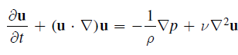
Review
Vortex Rings are vortices produced by turbulence from an external source.
As a single entity, the body shows similar behaviour in ideal(inviscid) and viscous flow.
However, interactions with other vortex rings and other solid bodies show deviations.
The vortex rings in general can be described by the governing equation
div(u)=0
The vorticity Ω and the velocity u, decrease and increase according to the gaussian function which is dependent on core radius and circulation.
As two (opposite circulation) vortex rings approach each other, they cause mutual induction as a result of which axial velocity decreases but radial velocity increases.
In case of identical vortex rings,the velocity rediction and the radial expansion are similar to both.

Slide 4
Review(Contd.)
In case of CR > 1 or CR < 1, the core radii will be different leading to different rates of velocity reduction and expansion rates.
In this case, in close proximity, the induced velocity of thicker ring will be more than that of the thinner ring and will cause easy slip-over of thicker ring on thinner ring.
With increase in CR, there is a decrease in KE and vorticity dissipation but increases ensthrophy.
Increase in Re causes increase in vorticity intensity and ensthrophy.
If the ring release velocity is very high and the Re is also along the higher line, the ring develops a wavy nature.
When 2 vortex rings of this type interact there is a formation of vortex ringlet and loops.
Depending on the value of CR, the ringlets form have different angles from the plane of collision.
The temporal trends in KE, Ensthrophy are same as before.

Slide 5
Proposition
Determining the effect of vorticity and azimuthal wave number on ringlet size and angle of deviation
Implementation Methodology
Changing exit velocity through orifice to change wave number and evaluate changes in ringlet dimension.
We know, higher CR means a higher angle of deviation from the plane of collision.We can fix CR and modulate the circulation values to bring changes.

Slide 6
Presentation - II
Vortex Ring Formations

Slide 7
Papers Covered
VORTEX RINGS - EXPERIMENTS AND NUMERICAL SIMULATIONS -Damian , Talasce, Simonesque Mihailescue
Analysing a single vortex ring after formation.
Circulation Generation- Rosenfield
Process of creating vortex rings from circular nozzles
Vortex Ring Time Scale – Karim, Rambod and Shariff

Slide 8
Ansys Simulations Update
Have tried analysing transient fluid flow through a nozzle alone.
Yet to setup the container system for the nozzle in 3D to make the formation of vortex.
Learning UDF for making variable input parameters for changing vortex size and circulation.

Slide 9
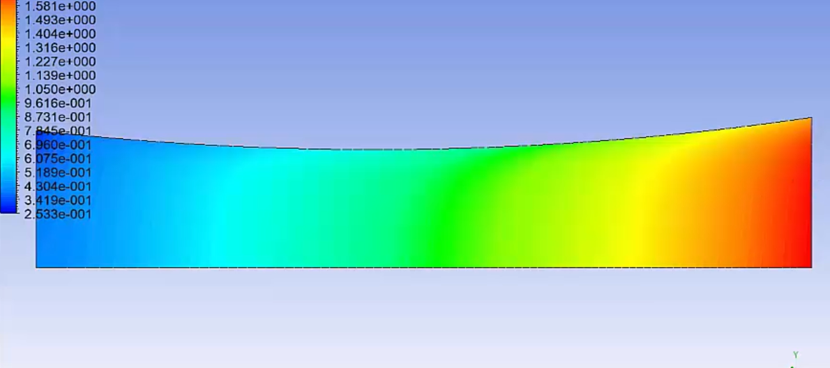
Single Nozzle Flow(Trial)

Slide 10

Presentation-III
Formation of vortex rings and starting collisions

Slide 11
Papers Reviews (Vortex Formation)
The Ring Vortex: Concepts for a Novel Complex Flow Phantom for Medical Imaging – Ferrari, Ambrogio, Walker and more
Governing Equations on Vortex Ring
Method For creating Vortex Rings in ANSYS
Velocity UDF set up
Numerical Simulations of 3D Compressible Vortex Ring– Dora and more
General Dimensions of apparatus
Difference between density dependent and independent vortex rings
Circulation Generation and Vortex Ring Formation by Conic Nozzles – Rosenfield, Katija, and Dabiri
ANSYS Setup for Vortex ring formation
Dependence of nozzle length and exit diameter on ring characteristics.

Slide 12
Papers Reviews (Vortex Formation)
Direct numerical simulation of a laminar vortex ring – James, Madnia
Numerical Techniques on the formation of vortex rings
Whether to choose nozzle or orifice.
Simulations of the formation of an axisymmetric vortex ring– Heeg and Riley
General Dimensions of apparatus
Difference between density dependent and independent vortex rings
Vortex Dynamics – PG Saffman
General Equations of Vortices
Relation between modulating terms and ring characteristics

Slide 13
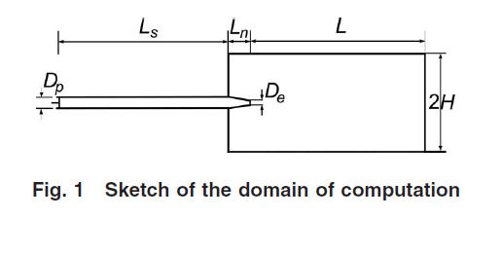
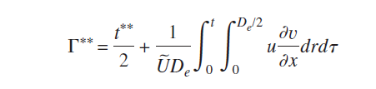
Review
Formation of vortex rings is directly possible through orifices and nozzles.
Vortex rings are analytically classified into 3 types – Hill, Thick and Thin
In case of nozzles the following points must be kept in mind :
Two sections:
A straight tube of length Ls= 40 cm and a constant diameter of Dp=2.5 cm
A conic nozzle of length Ln=5.1 cm dimensions are chosen to match the experimental setup and exit diameter De of De /Dp=0.2, 0.4, 0.6, 0.8, or 1. The computational domain downstream of the nozzle exit has a length of L/Dp=32, and the outer boundary is at a radial distance of H/Dp=4.
An orifice is a limiting case of a nozzle when De /Dp=1 and L=0
The circulation of a vortex ring is directly dependent on the De/Dp
ratio.
On the similar lines, for a given circulation and impulse, the kinetic energy is inversely dependent on the diameter ratio as mentioned above.
Decreasing the length increases the 2-dimensional component of the ring, thus increasing circulation.

Slide 14
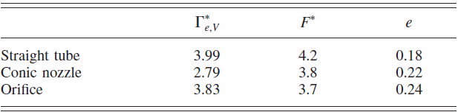
Comparison

Slide 15
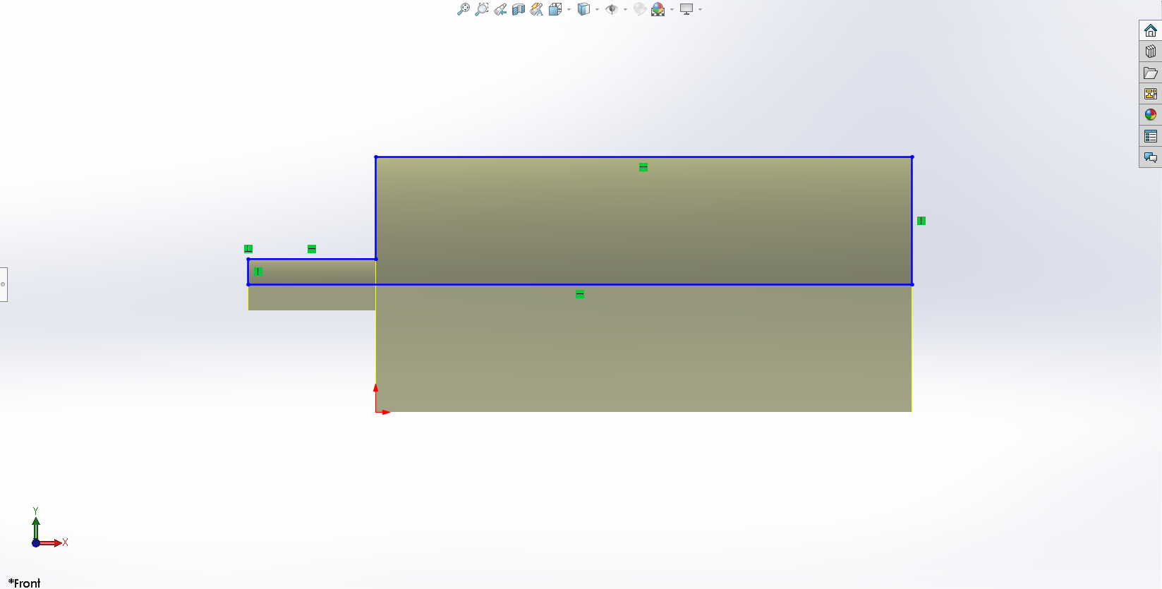
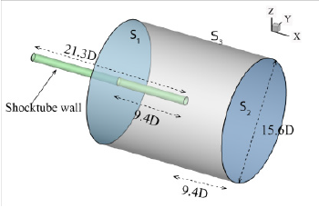
Design Used

Slide 16
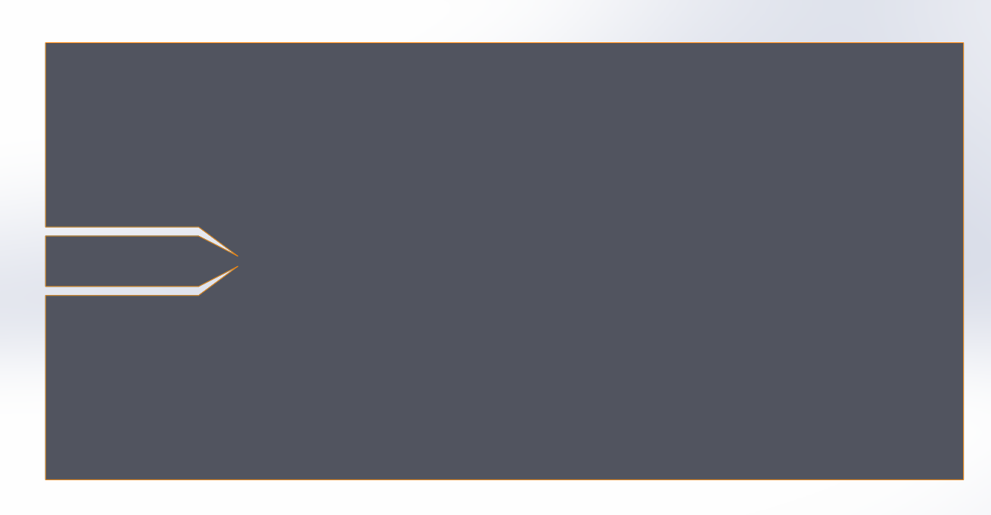
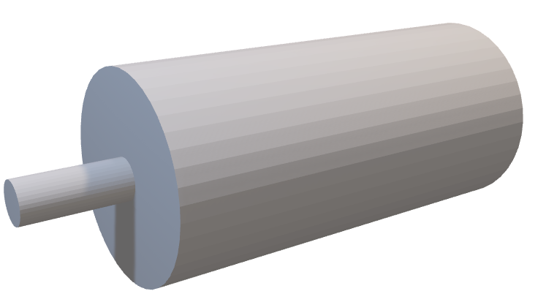
Model

Slide 17
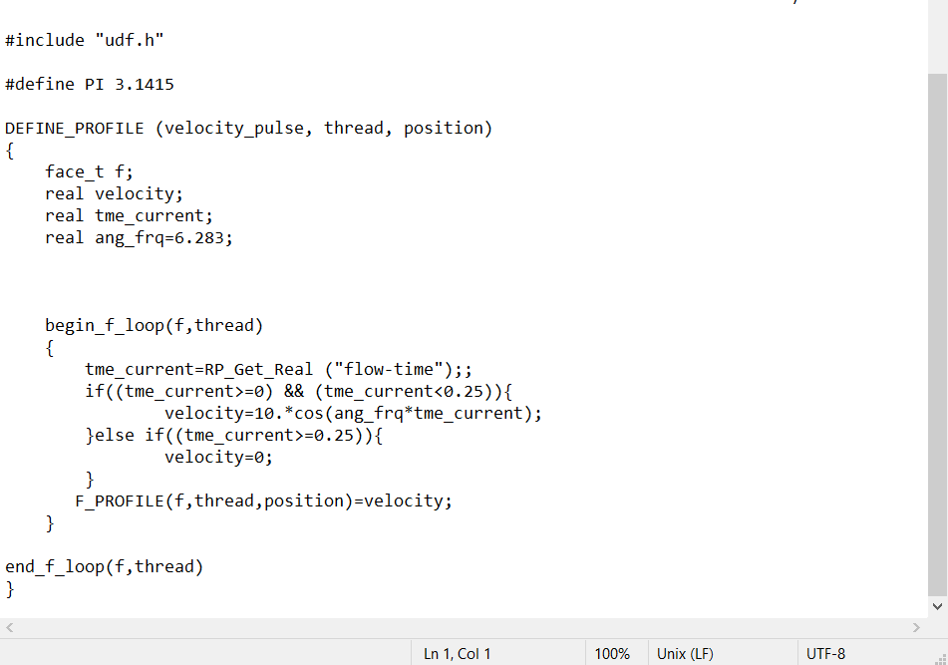
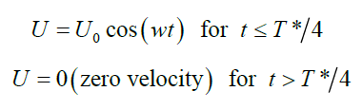
UDF Used

Slide 18
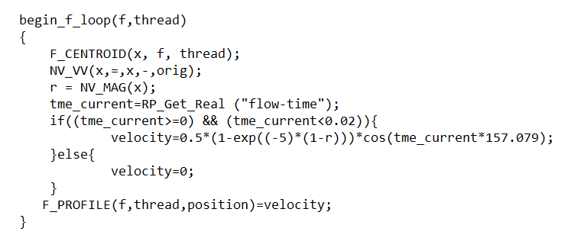
Modified UDF for Explicit Slug Formation
This UDF considers an exponential decrease in the initial velocity amplitude at the starting point.

Slide 19
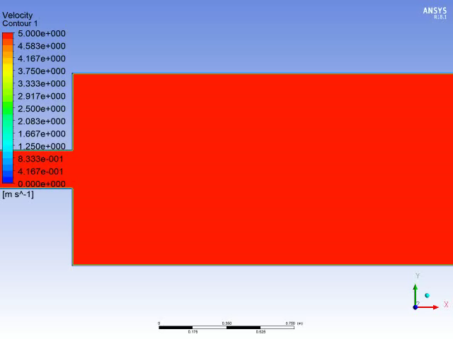
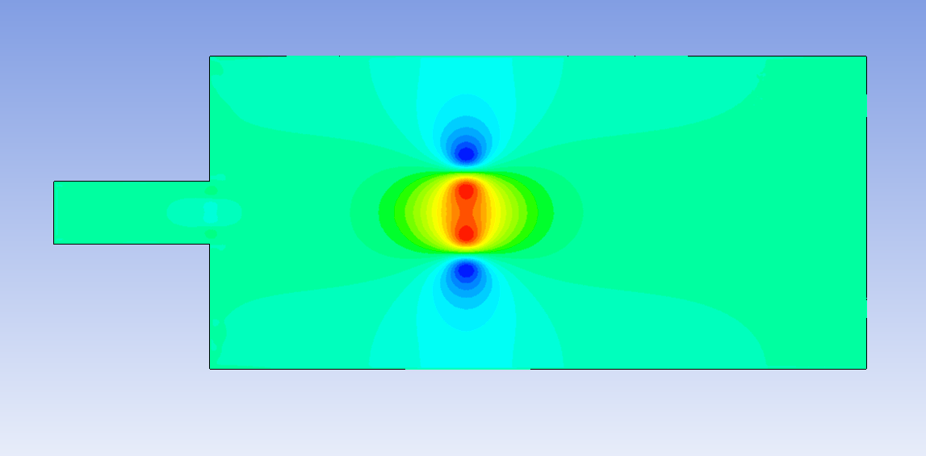
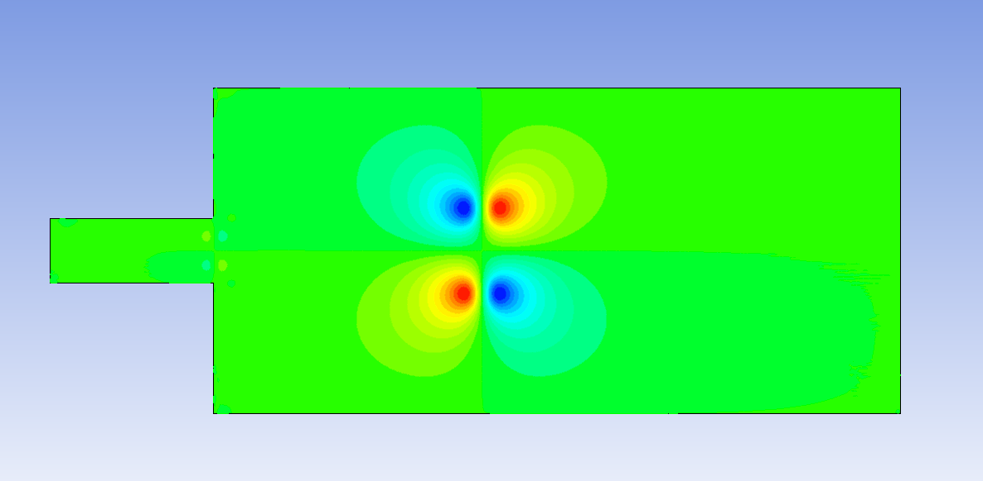
Current Simulations
X - Velocity
Y - Velocity

Slide 20
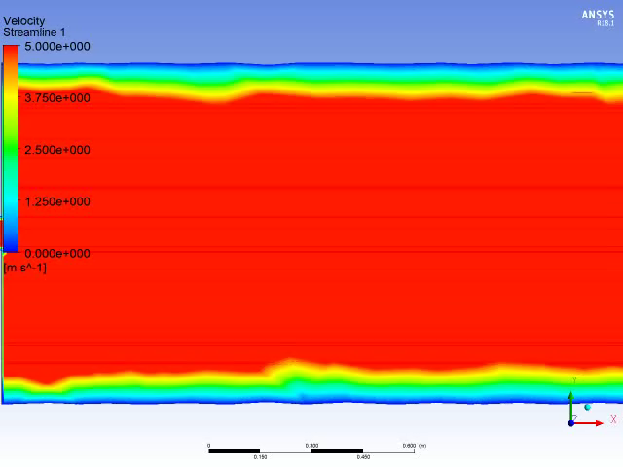
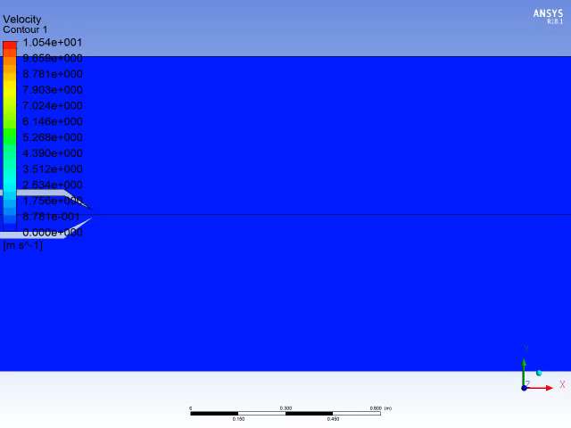
Current Simulations

Slide 21
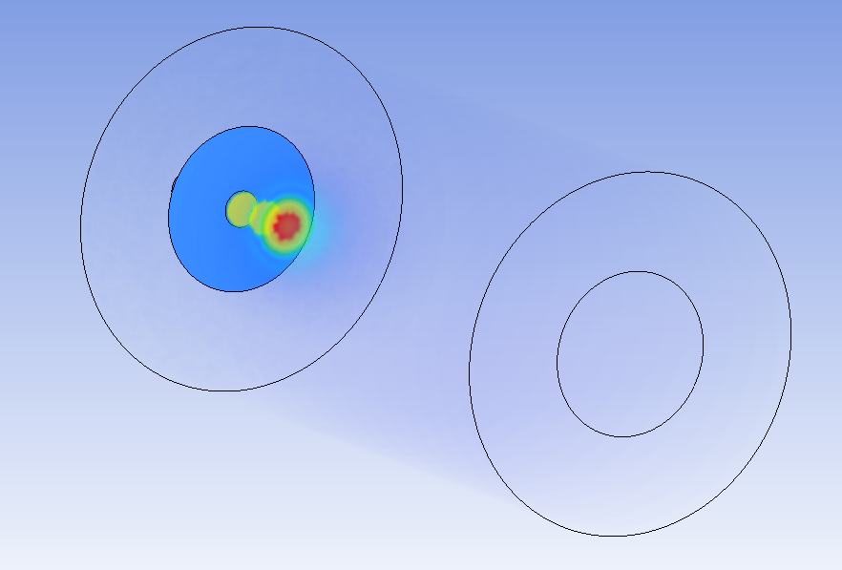

Slide 22
Collission Papers Covered
Numerical simulation of head-on collision of two coaxial vortex rings – Cheng, Lou
Head-on Collision of laminar vortex rings – Stanway Shariff

Slide 23
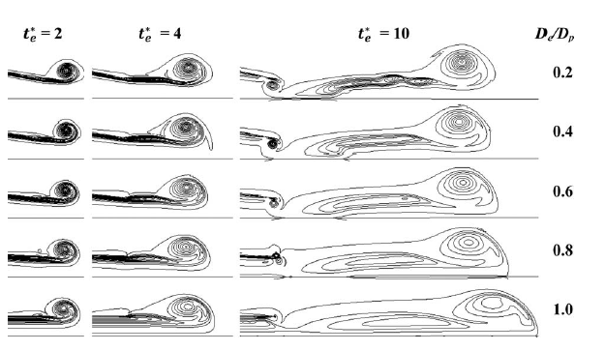
External Points Seen
Optimum density fluids have to used for easier visualization of the collision and for maintaining the strength of the ring.
Collision should take place at points further away from the exit, especially in case of an orifice.
Identical coaxial rings will be formed by same exit diameter and length.
Coaxial rings with different core radii can be formed by changing between orifice and nozzle. However, length should be kept constant to account for the same 2-dimensional component.

Slide 24
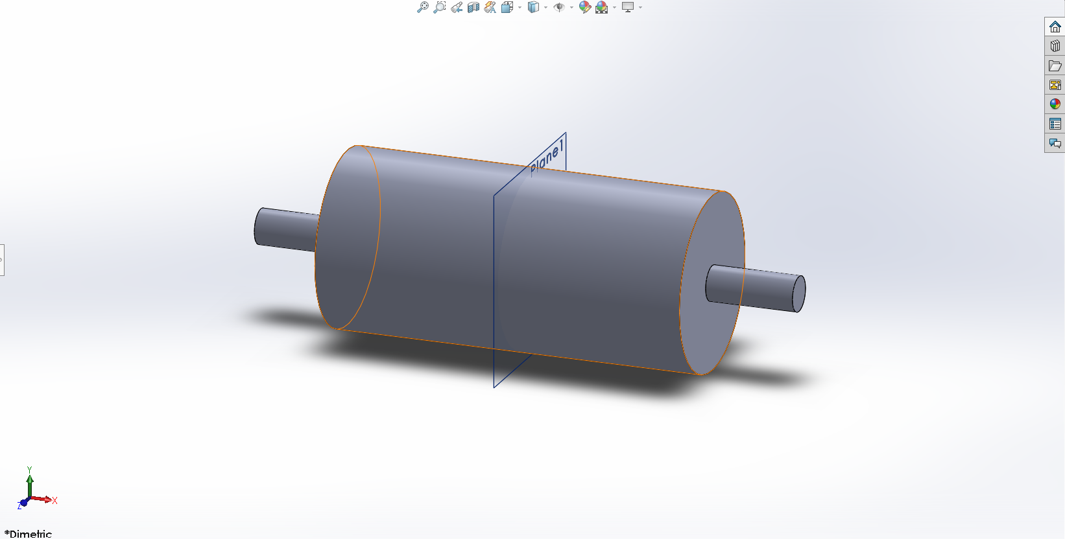
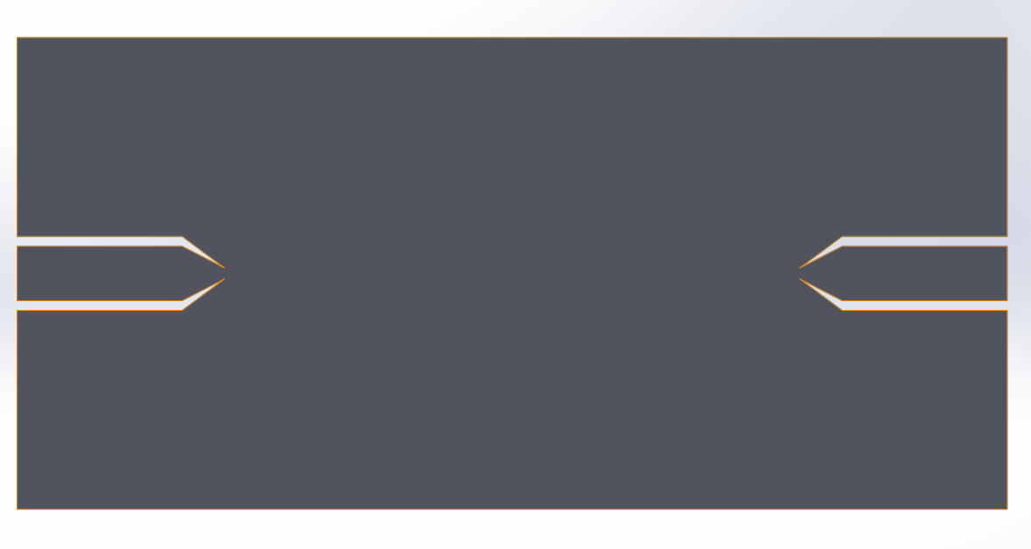
Collision Update

Slide 25
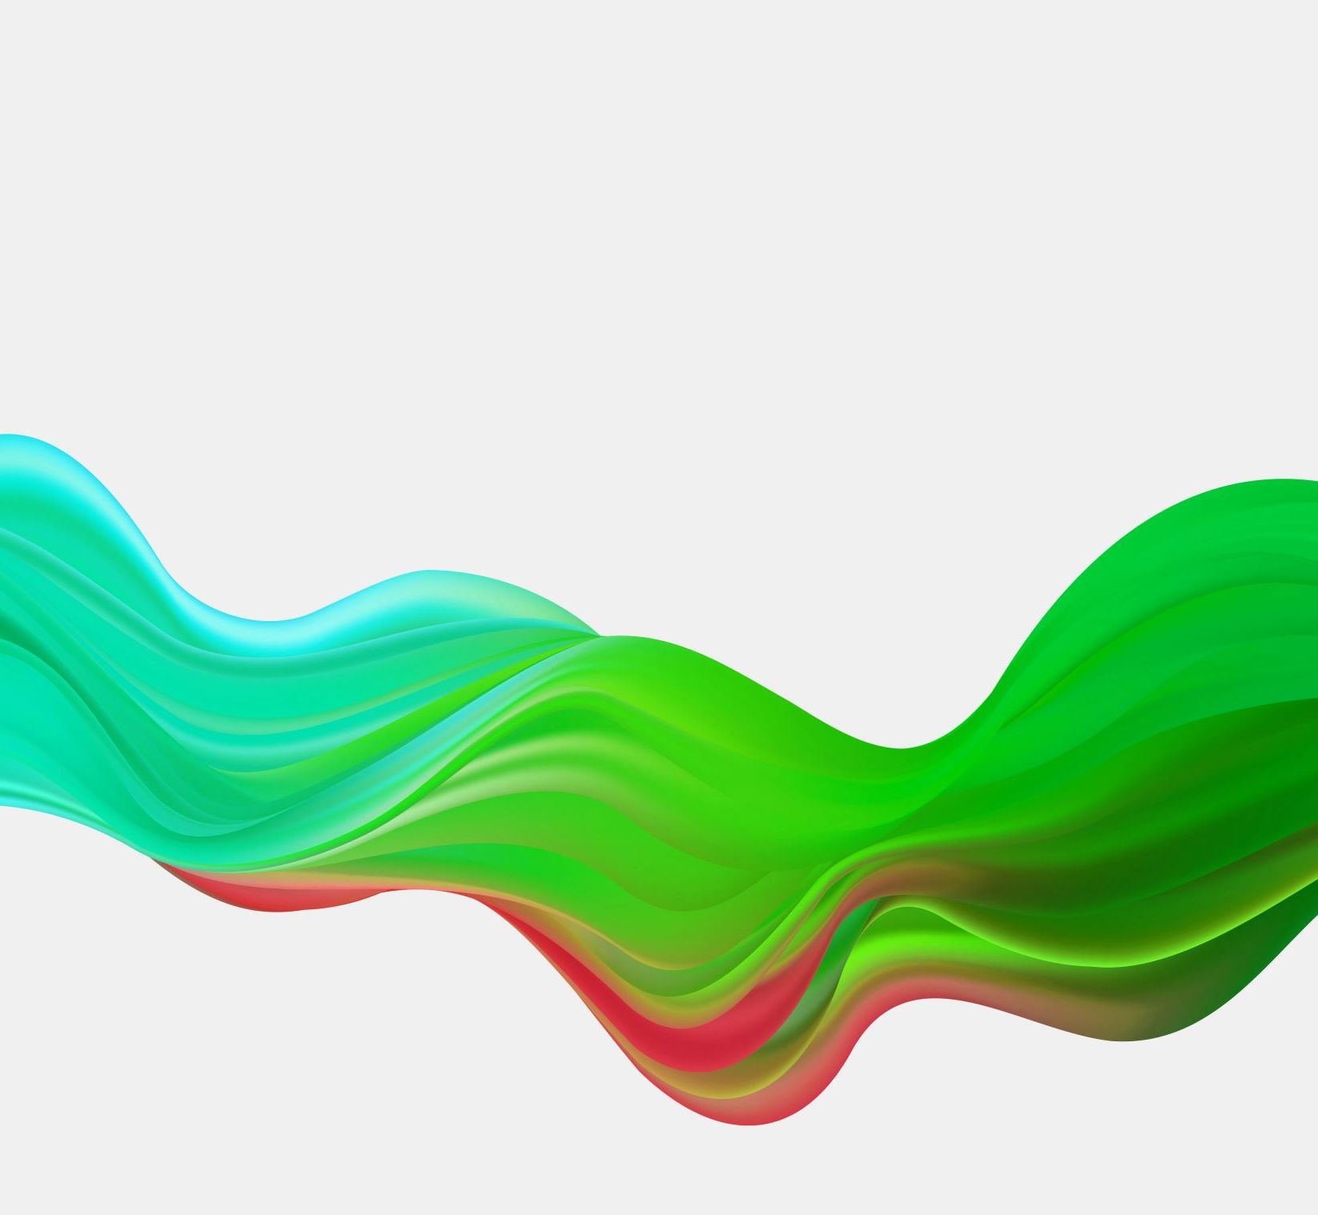
Presentation- IV
Vortex ring collision validation

Slide 26
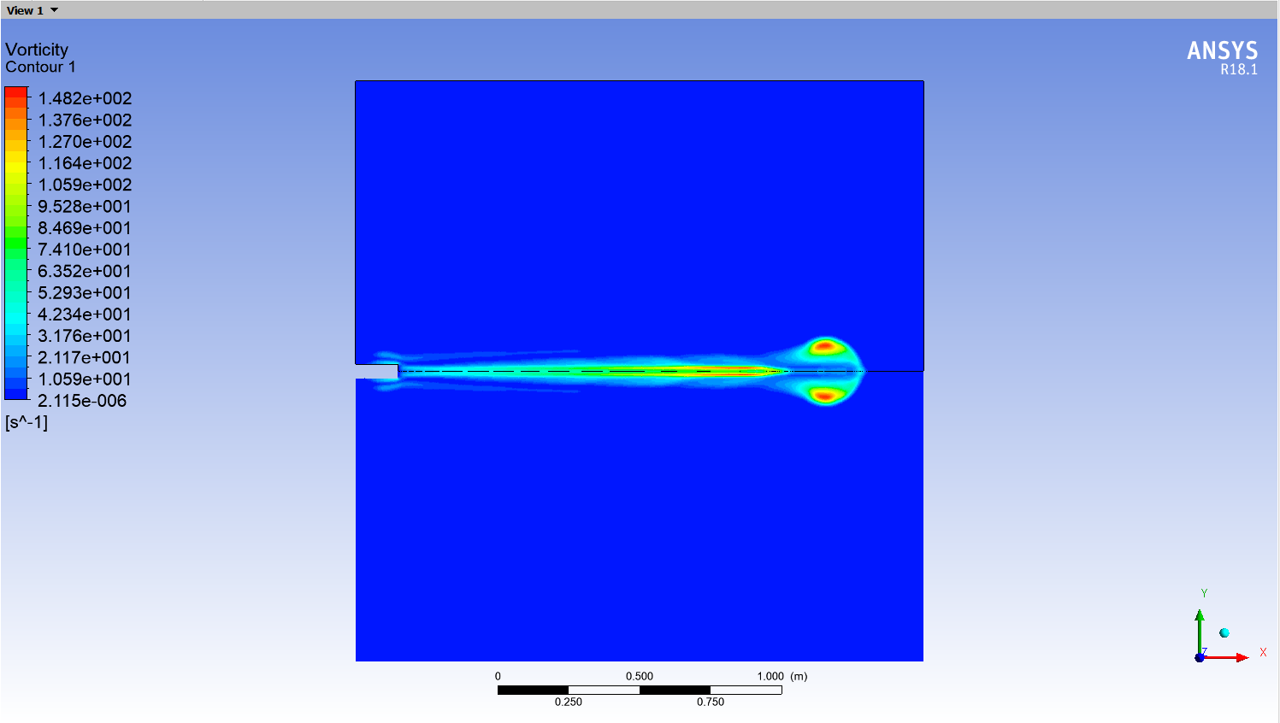
Clarity of Ring

Slide 27
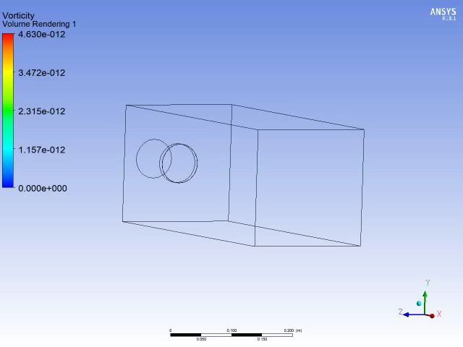
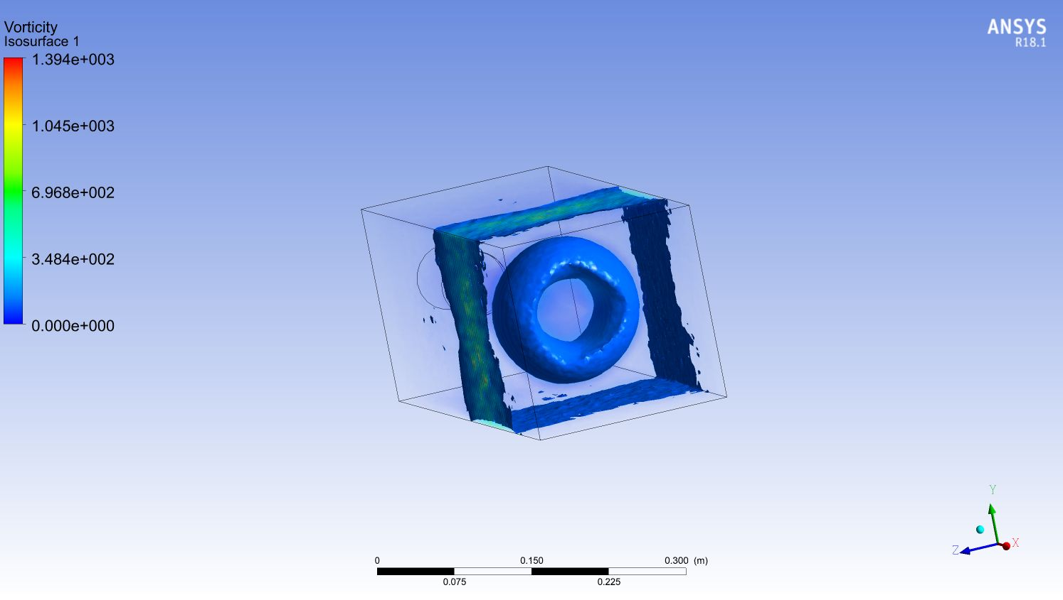
Clarity and Stability

Slide 28
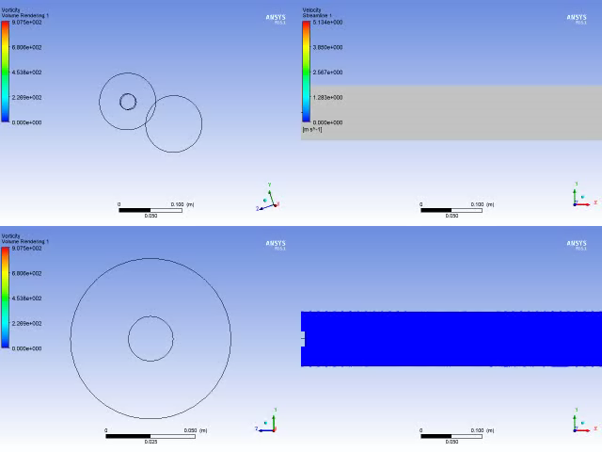
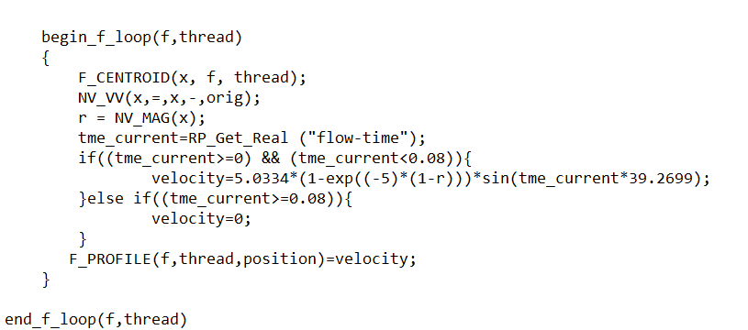
Oshima Trials

Slide 29
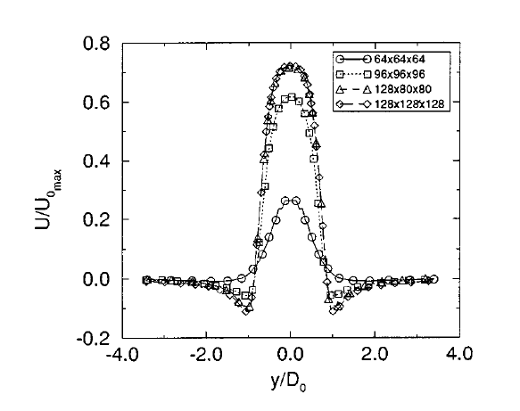
Validation (Net Velocity Distribution with radius)

Slide 30
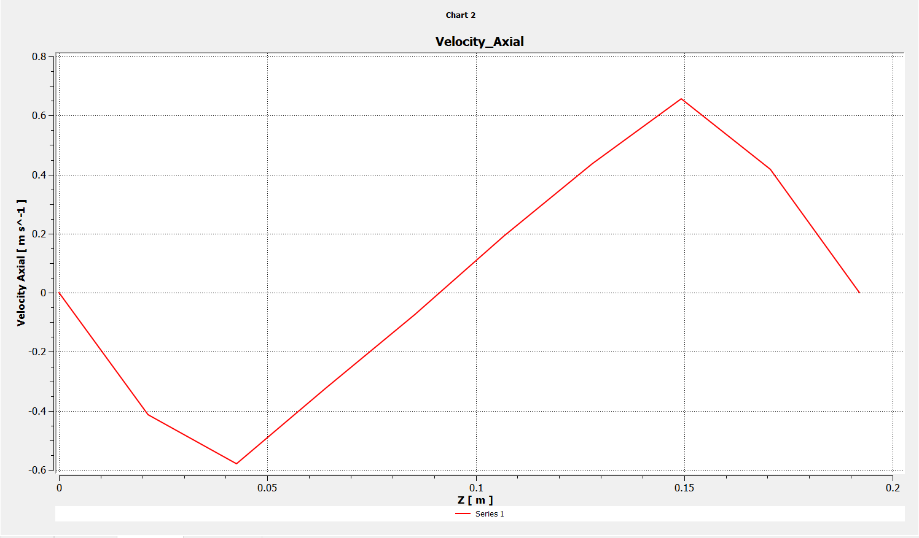
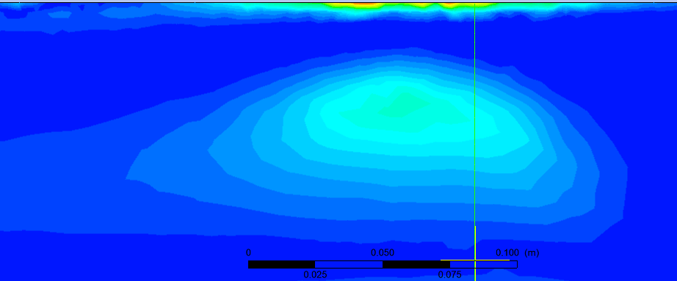
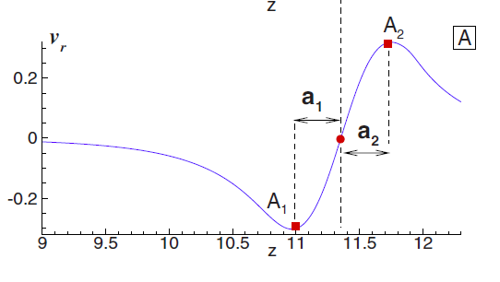
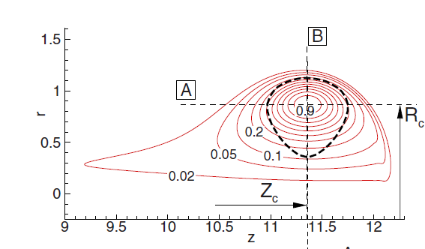

Slide 31
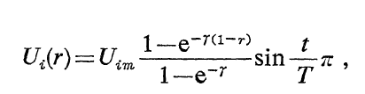
Collission (Papers Covered)
Interaction of Two Vortex Rings moving Along common axis of symmetry – Oshima, Kambe, Asaka
Numerical Approach to collision
Provided slug model for the collision process
In this experiment, 1 D collision was created between 2 rings moving in same direction.
Numerical Simulations of Two Coaxial Vortex Rings Head-on Collision – Guan , Wei and more

Slide 32
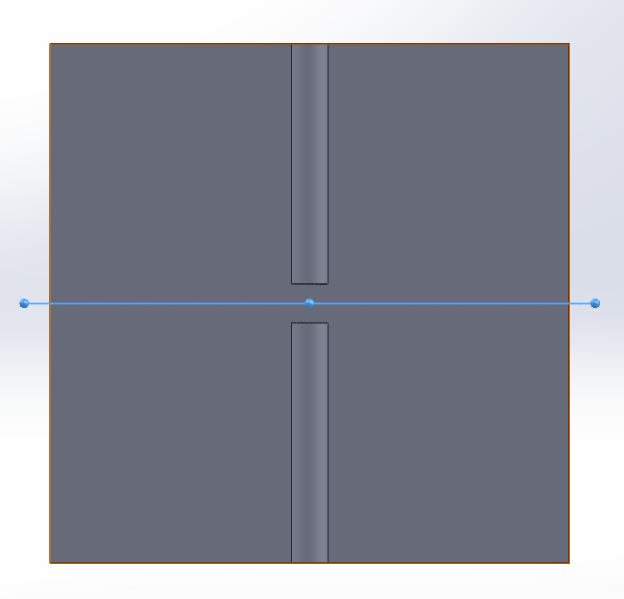
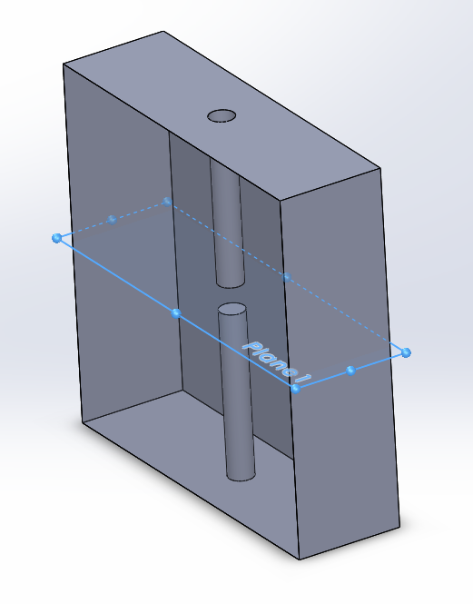
System Used

Slide 33
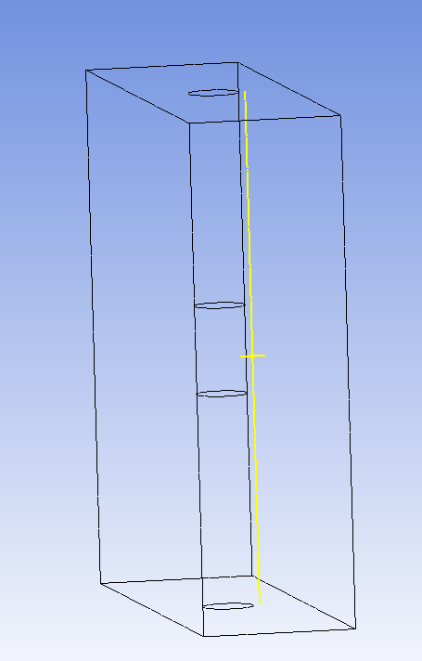
Measurement Points

Slide 34
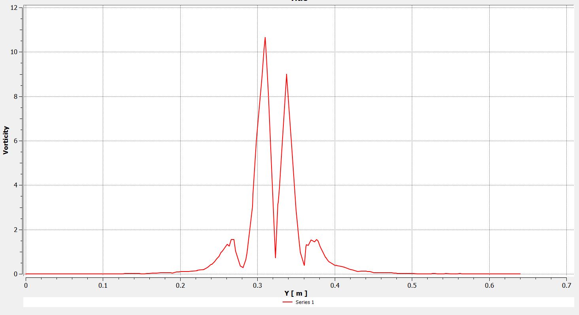
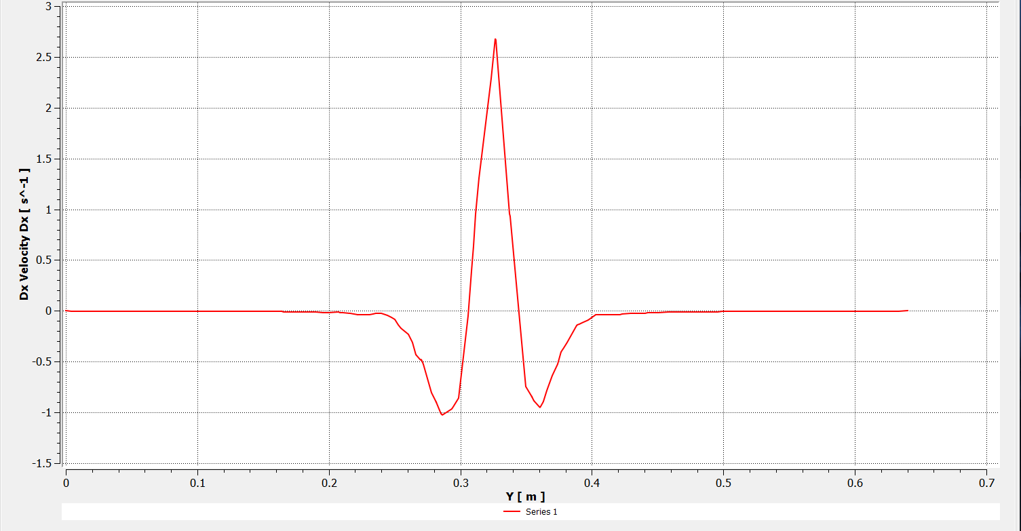
Vorticity Plots

Slide 35
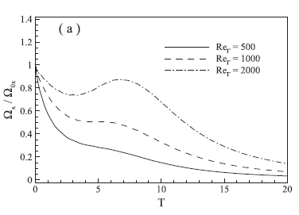
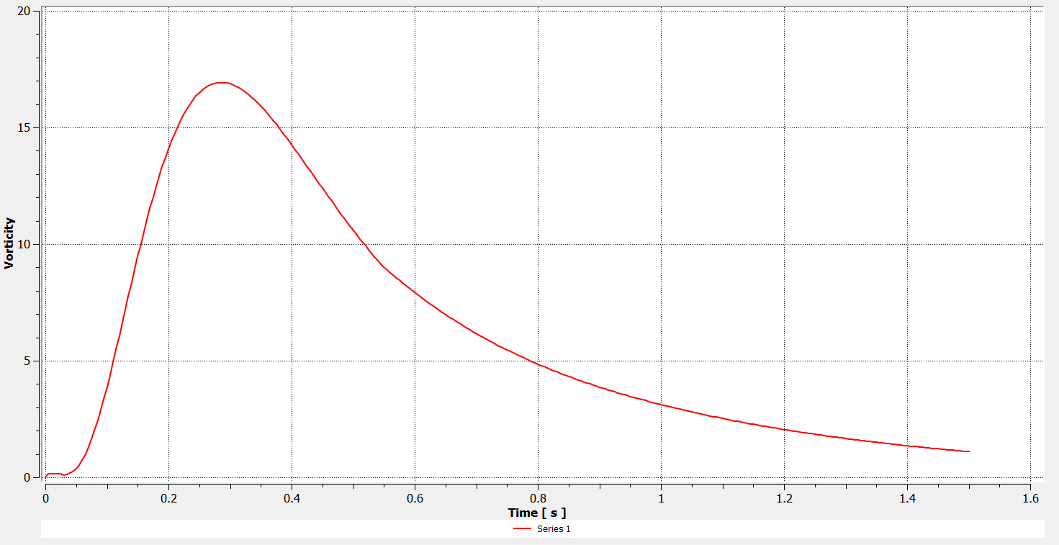

Slide 36
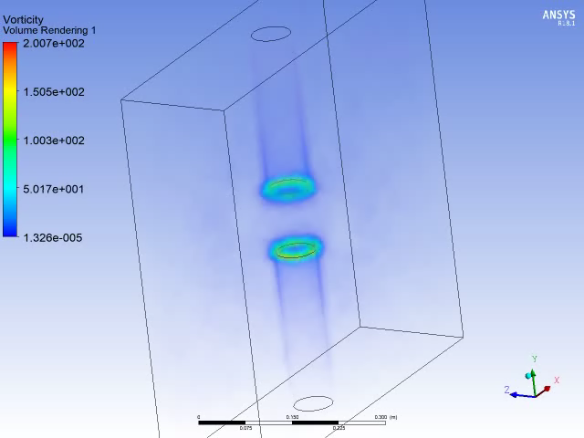
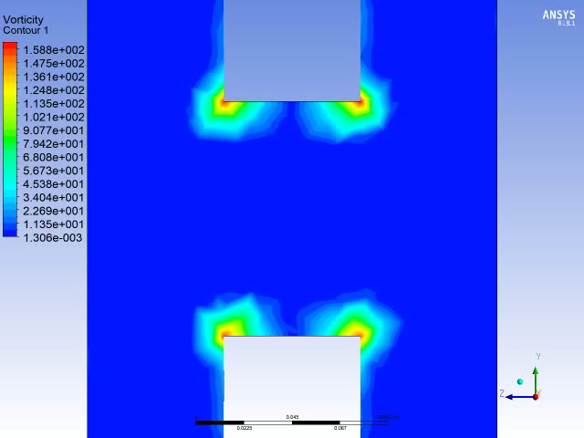
Simulations Based on Cheng Papers

Slide 37
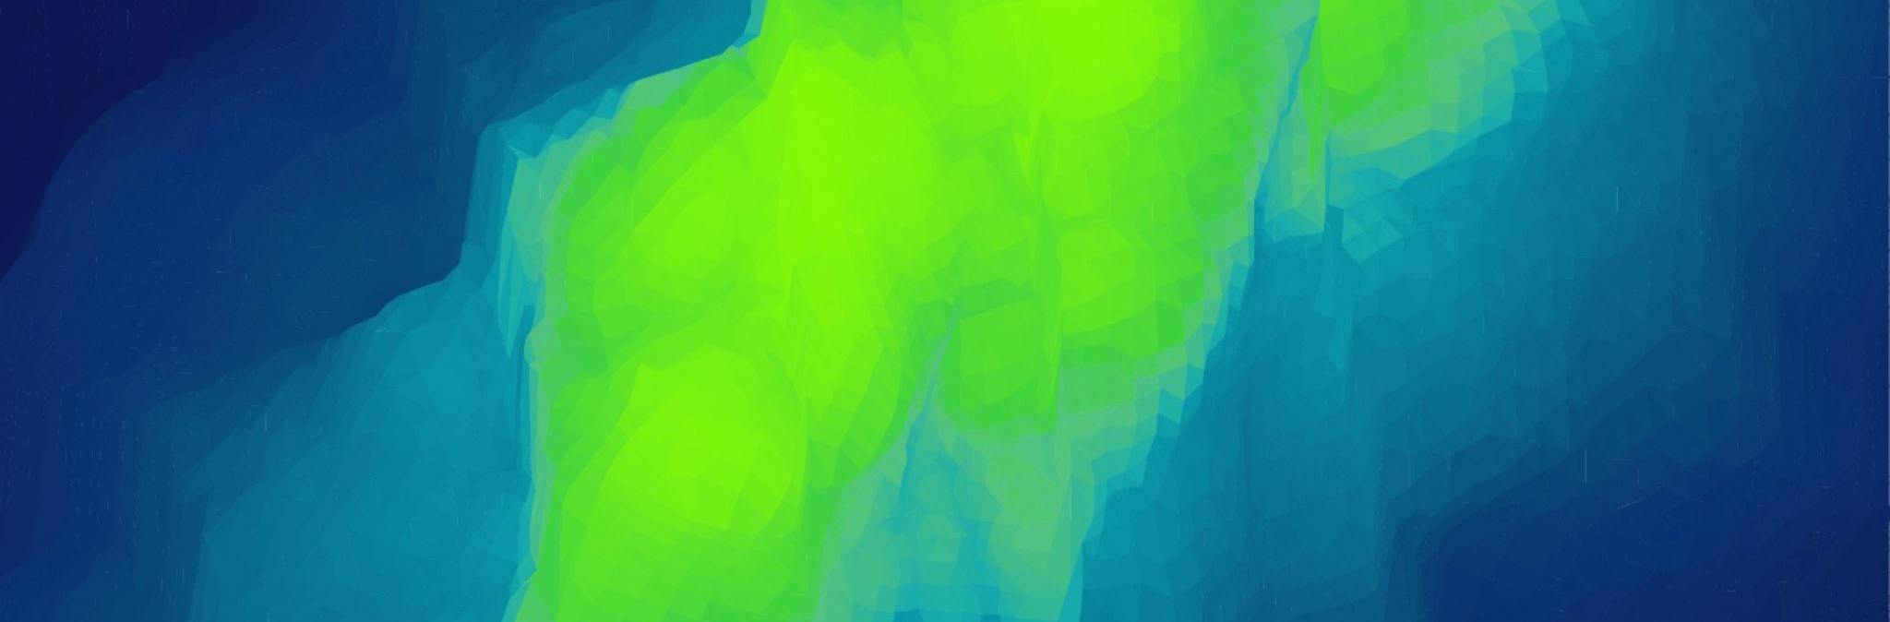
Presentation V
Moving Planes and MATLAB

Slide 38
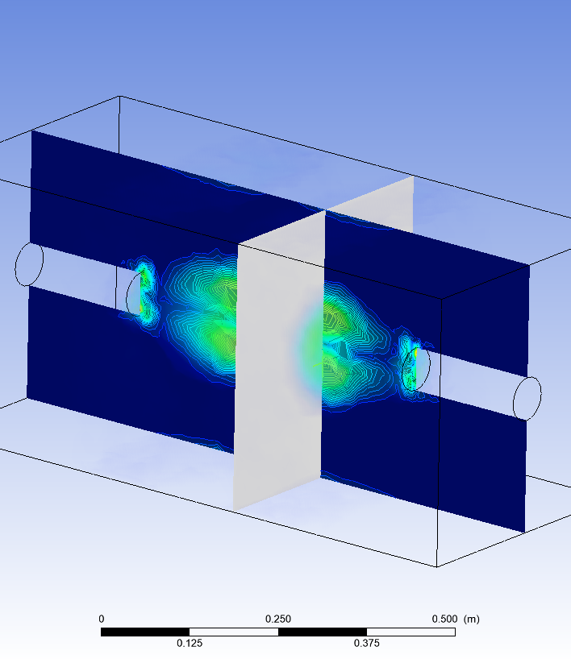
Dynamic Contours
Set up an expression to move the plane to the position of the maximum vorticity.
True value of radius can be measured by this.
Set up a point at Maximum Vorticity, Probed coordinates at that point to set up the plane and then moved the plane along the X direction.

Slide 39
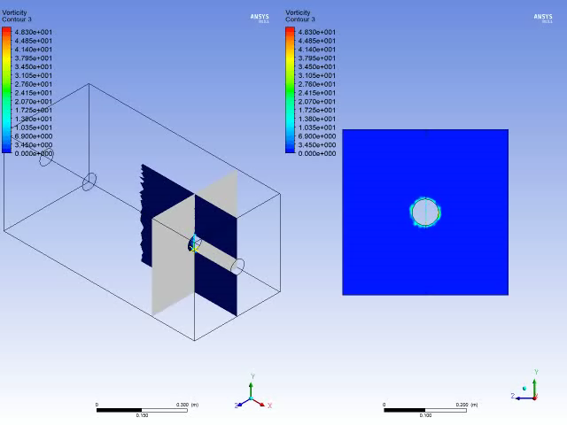

Slide 40
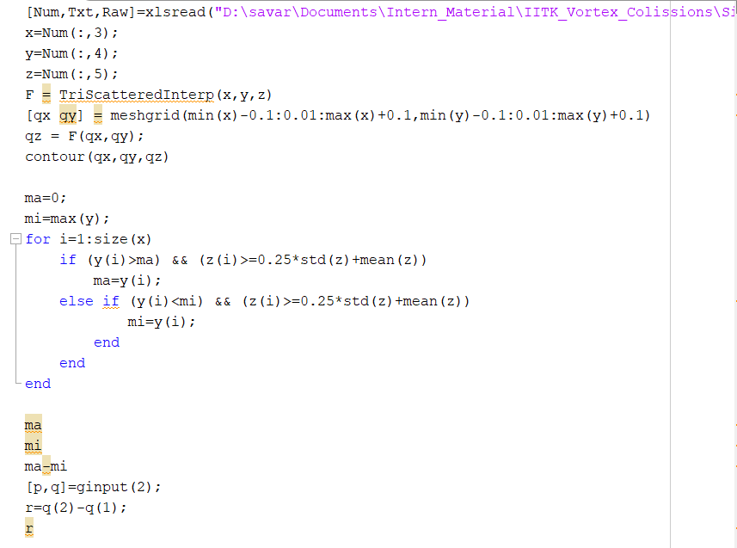
Plotting Radius
Files at 15 timesteps were taken and exported to MATLAB.

Slide 41
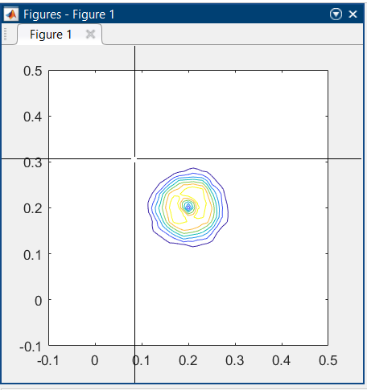
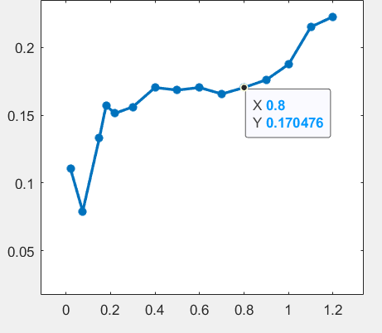

Slide 42
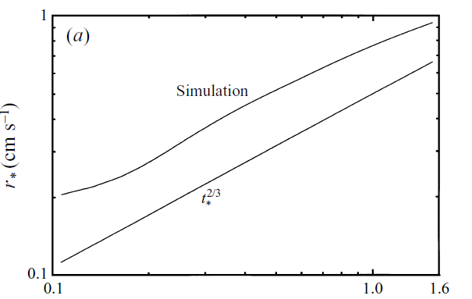

Slide 43
Circulation Ratios
Polyline was created at average points of the ring.
Line integral of tangential velocity was taken along the polyline.
Plot was made directly in CFD-Post as polyline couldn’t be exported to MATLAB.

Slide 44
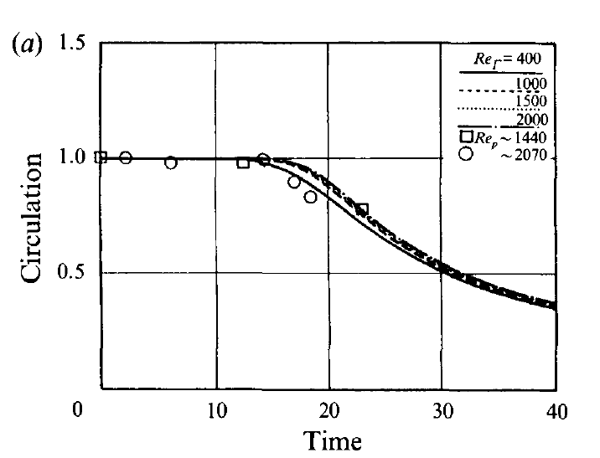



Slide 45


Slide 46

LIM NICKELS MODEL

Slide 47

Presentation - VI
Instability Model, Looping and Slow Trials

Slide 48

Instability Trials

Slide 49
Azimuthal Instability
Happens at higher Reynolds number
Current analysis performed at 2000 Reynolds number.
Apparatus same as earlier.
The only exception is that the speed was increased tremendously to 15 m/s to provide N = 15.

Slide 50


Slide 51



Radius Growth in Instability Case

Slide 52

Diameter vs Time
(High Velocity)
Diameter vs Time
(Low Velocity)

Slide 53
Visualisation
Isosurfaces were made Average + 20% Std. Deviation in order to maintain visibility.
As soon as collision started, the sine wave perturbation was seen and the looping mentioned was observed.

Slide 54


Slide 55


Perturbation based linking
Local Looping for shorter ring formation

Slide 56


Secondary Collissions

Slide 57


There is a secondary collision which occurs slightly concentric regions of high vorticity to the major collision.

